Slide 1




Library Management System
Advance Java Programming (MCS-313) Final Assignment
Karan Tiwari
August 2026

Slide 2




Overview: The Problem
Manual Operations: Handling catalogs, members, and book loans manually is slow and error-prone.
Tracking Failures: Librarians struggle to track overdue books and generate accurate data reports.
Poor Experience: Lack of automation leads to lost inventory, delayed alerts, and frustrated members.

Slide 3

Overview: Project Objectives
Automate Operations: Streamline daily tasks including catalog management and circulation workflows.
Secure Access: Implement a strict, role-based system for Administrators, Librarians, and Members.
Smart Tracking: Implement automated tracking for book loans and overdue email notifications.
Data Analysis: Generate exportable PDF and CSV reports for administrative review.
Data Integrity: Maintain a strict activity audit log and provide a clean frontend interface.

Slide 4

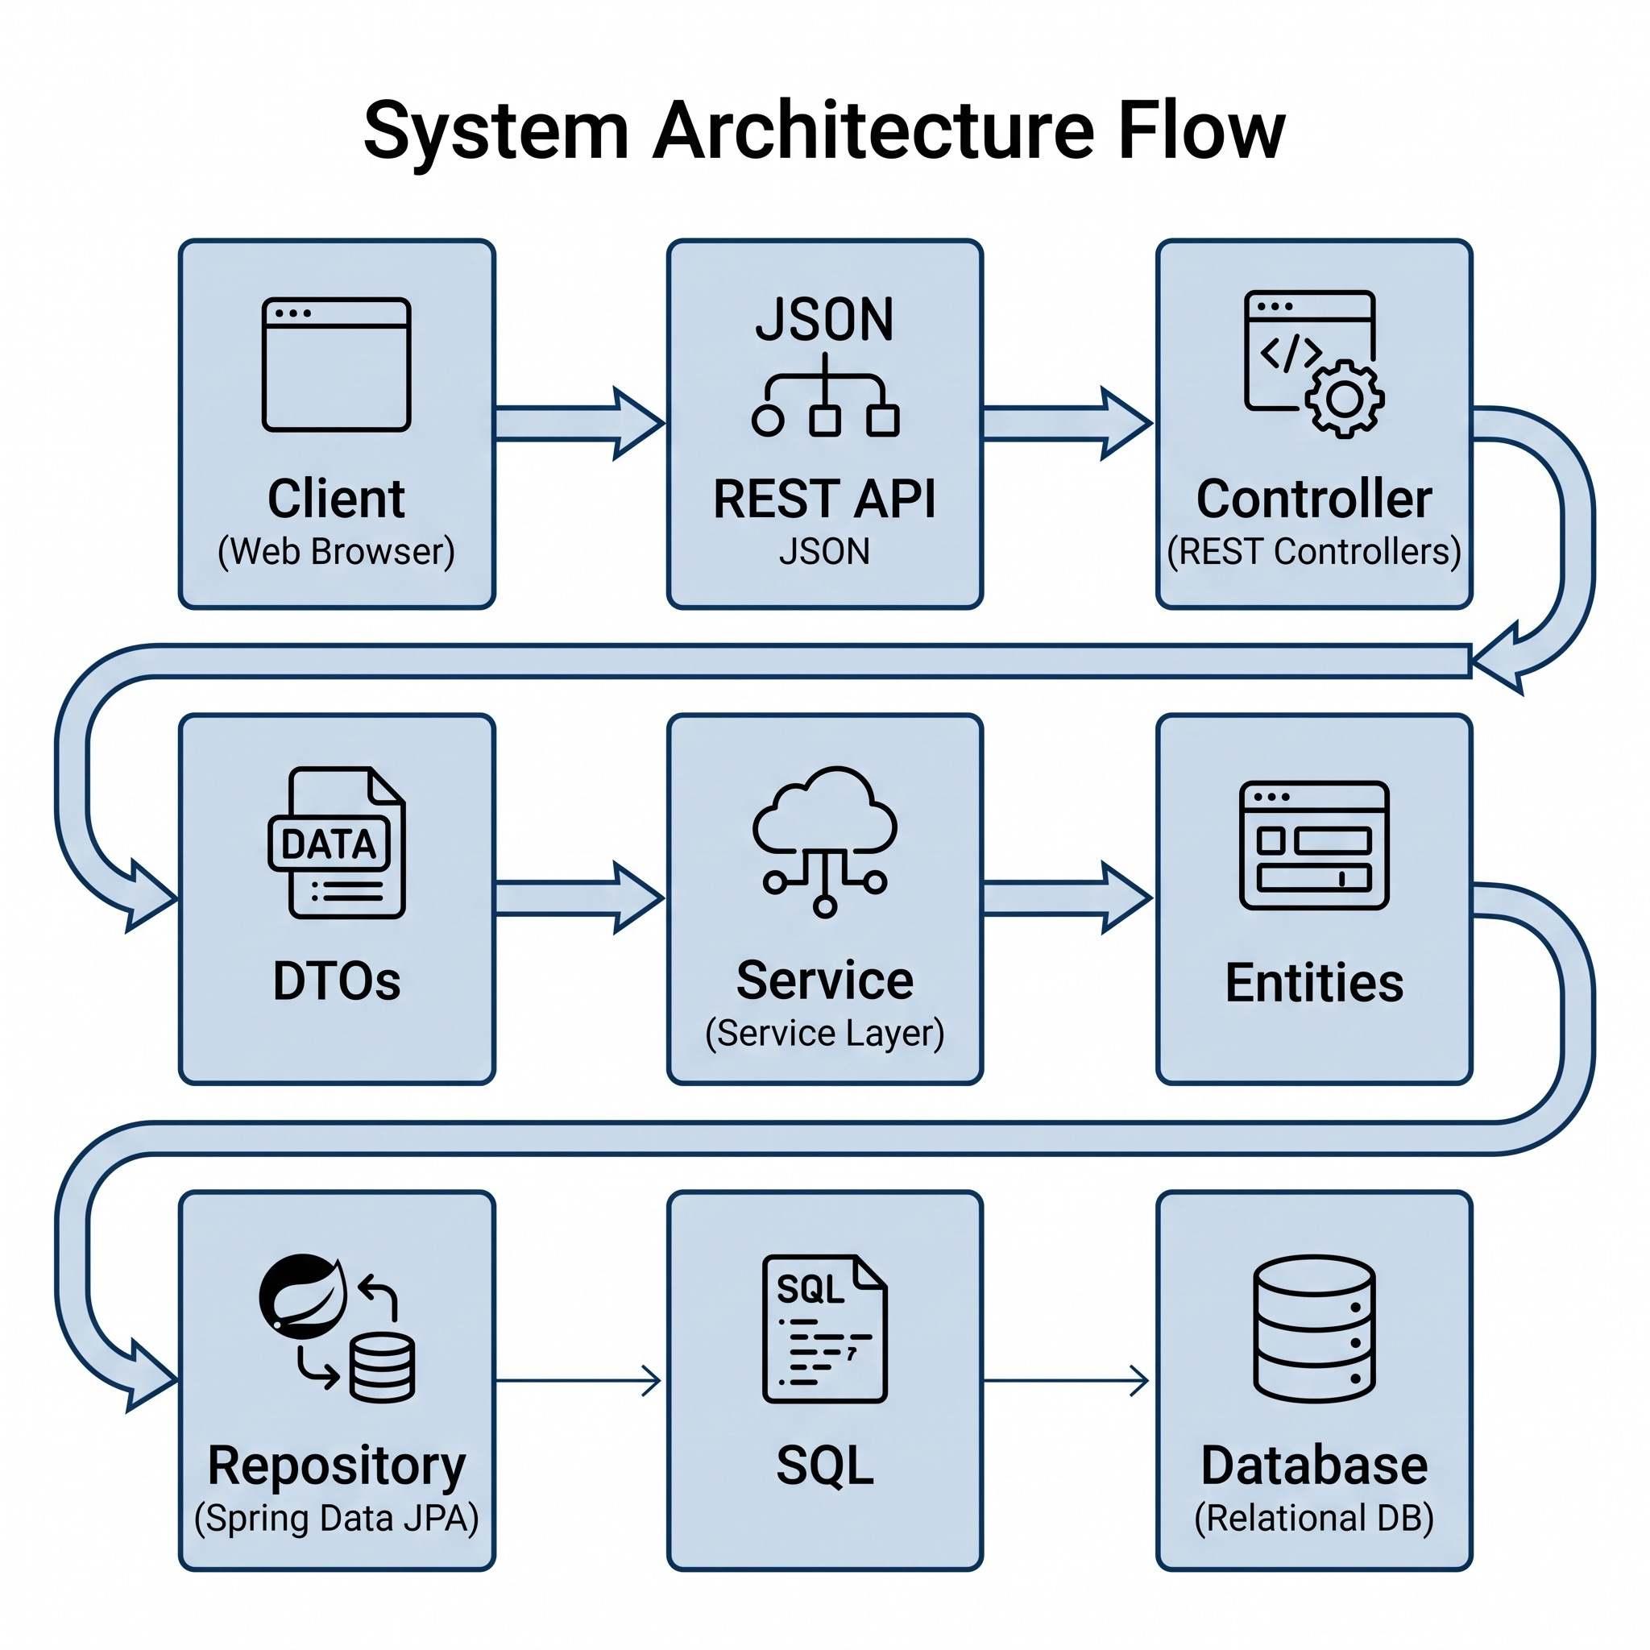
Spring Boot Architecture Design
Presentation Layer: HTML & TailwindCSS frontend interacting via REST APIs (JSON).
Controller Layer: Spring MVC REST Controllers handle HTTP requests and validation.
Service Layer: Contains core Java business logic and transaction management.
Data Access Layer: Spring Data JPA repositories interfacing with the relational database.

Slide 5


Database Design (Normalized Schema)
Entity Name | Attributes & Relationships
USER / ROLE | PK: id username, password, email, fullName | role_name
MEMBER | PK: id email, fullName, phone
BOOK | PK: id title, isbn, publicationYear FK: author_id FK: category_id
AUTHOR / CATEGORY | PK: id name, bio | name, description
LOAN | PK: id loanDate, dueDate, status FK: book_id FK: member_id
AUDIT_LOG | PK: id action, username, timestamp

Slide 6







Features Implemented
Catalog & Access
Circulation
Administration
Full CRUD: Manage Books, Authors, Categories, and Members.
Loan Management: Accurately tracks borrowed books in real-time.
Exporting: Generate Loan data (PDF) and Book data (CSV).
Audit Logging: Tracks all actions using Spring AOP.
Advanced Search: Pagination & Spring Data filtering.
Automated Scheduling: Identifies overdue status using @Scheduled.
Data Integrity: Transparent tracking of librarian workflows.
Security: JWT-based login with Spring Security Role-Based Access.
Email Alerts: Notifies members when books are overdue.

Slide 7





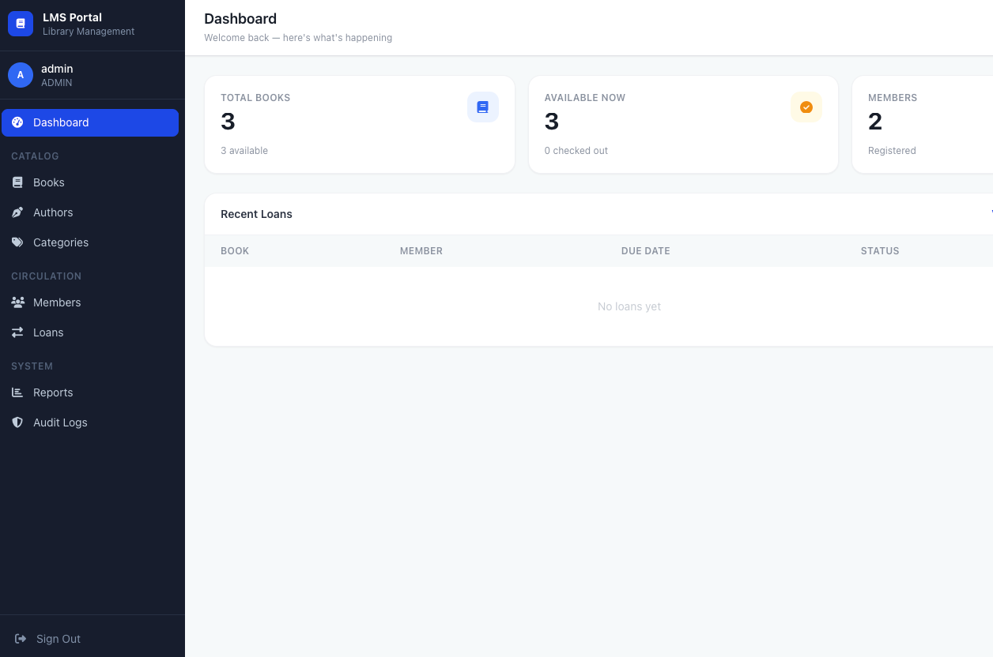
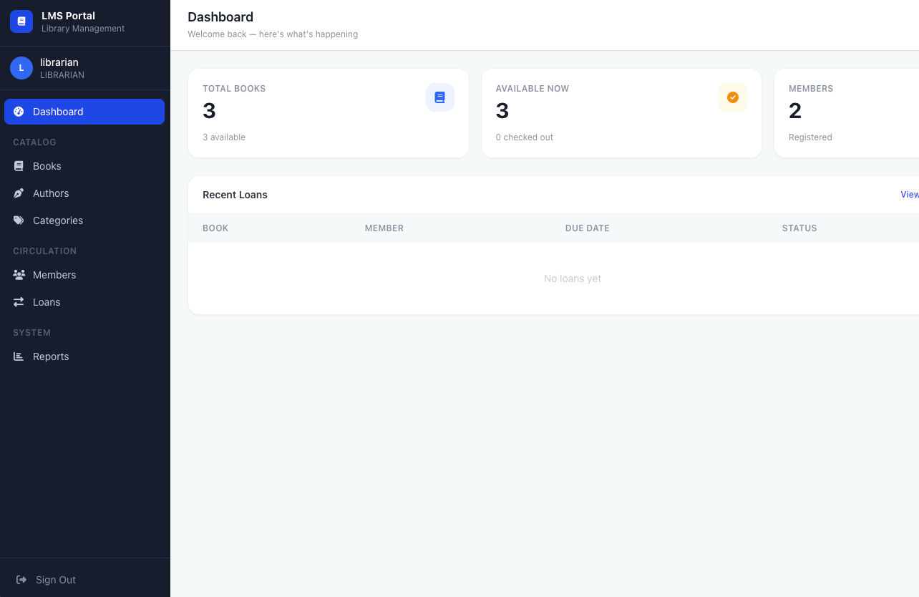
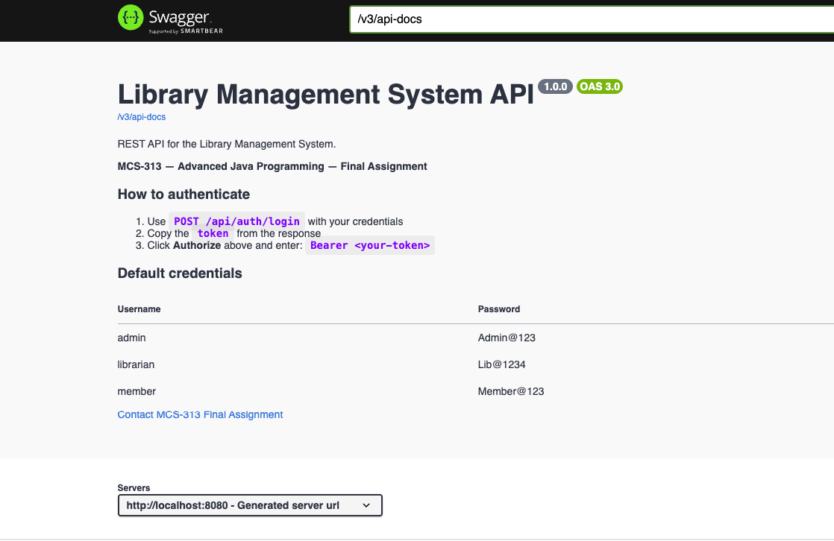
Demonstration Screenshots
Admin Dashboard
Member Catalog
API Documentation
High-level overview of system metrics and recent library activity.
Clean user view for browsing categories and tracking personal loans.
Interactive Swagger UI interface for testing backend REST endpoints.

Slide 8

Technologies Used
Frontend & Utilities
Java Backend Core
UI Layer: HTML5, Vanilla JavaScript, TailwindCSS
Framework: Java 17 & Spring Boot 3.x
Reporting: OpenPDF (PDF Export), OpenCSV (CSV Export)
Database: Spring Data JPA, Hibernate, MySQL, H2
Security: Spring Security & JSON Web Tokens (JWT)
Tools: Spring Mail (Emails), Swagger UI (Docs), Maven

Slide 9









Future Enhancements
Mobile Application
Digital Payments
Develop native Android and iOS applications.
Integrate secure payment gateways (Stripe/PayPal).
Allow members to browse catalogs and reserve books on the go.
Automate the collection of late fees and subscription renewals.
RFID & Barcode
AI Recommendations
Integrate hardware scanners for rapid physical book checkout.
Analyze borrowing history using machine learning.
Suggest highly relevant books to members automatically.
Drastically reduce time spent at the librarian desk.

Slide 10


Project Concluded Successfully
The Library Management System successfully fulfills all objectives by providing a robust, scalable, and secure application using the Java & Spring Boot ecosystem.
Questions & Answers
Thank you for attending this presentation.

Slide 11





Image Sources
https://media.istockphoto.com/id/484494166/photo/school-books-in-decay.jpg?s=612x612&w=0&k=20&c=5ZLwVsouLndzXottMYWmeJ5mrfgFWhwy6iCupcX1JcM=
Source: www.istockphoto.com
https://stg-uploads.slidenest.com/template_4043/templateColor_3803/previewImages/it-network-infrastructure-powerpoint-google-slides-keynote-presentation-template-1.jpeg
Source: slidenest.com
https://media.easy-peasy.ai/810a45e1-0c9b-498d-a0aa-38ee610a8091/49e39538-ddd4-48b4-b775-d10b8bfc7ef8_medium.webp
Source: easy-peasy.ai
https://www.canto.com/cdn/en/2024/05/16170345/how-to-organize-digital-photos_feature.jpg
Source: www.canto.com
https://www.instinctools.com/wp-content/uploads/2026/06/vibe-code-audit-cleanup-img1.webp
Source: www.instinctools.com

